Slide 1
General Viva (CCE-4832)
DATABASE MANAGEMENT SYSTEM (CCE-3505)
Submitted By:
E193009 Zia Ul Hassan Chowdhury
Professor Engr. Md Razu Ahmed
Chairman, Dept of CCE,IIUC

Slide 2
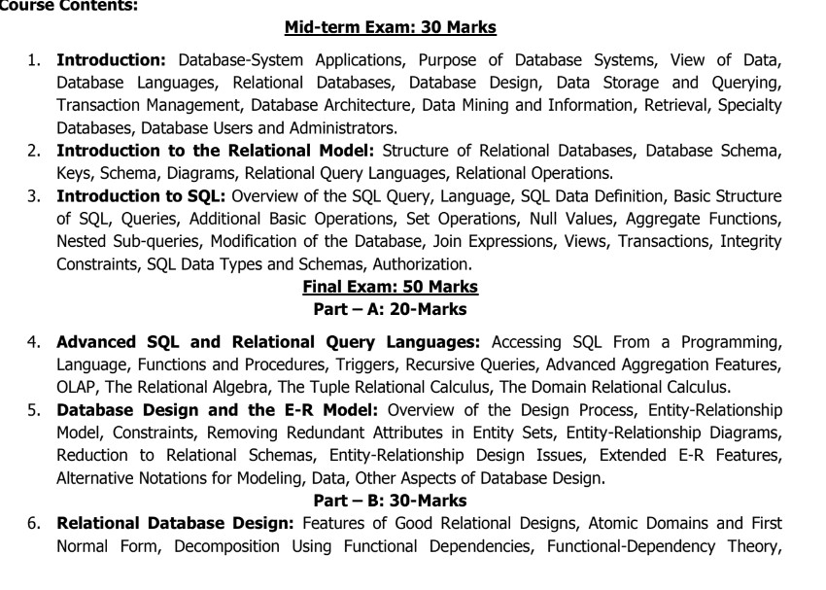

Slide 3
1. What is a Database?
Ans: A database is a separate application that stores a collection of data. Each database has one or more distinct APIs for creating, accessing, managing, searching and replicating the data it holds.
2. What is the purpose of Database management system?
Ans: Database systems are designed to manage large bodies of information. Management of data involves both defining structures for storage of information and providing mechanisms for the manipulation of information.
3. What is Relational Database?
Ans: A Relational Database is a type of database that stores and provides access to data points that are related to one another.
4. What is the view of data?
Ans: view of data in DBMS describes the abstraction of data at three-level i.e., physical level, logical level, view level.
5. What is database design?
Ans: Database design is the organization of data according to a database model.

Slide 4
6. What is MySQL?
Ans: MySQL is a database system used on the web.
7. What is data storage in dbms?
Ans : Databases are stored in file formats, which contain records.
8. What is transaction management?
Ans: Transaction management is a logical unit of processing in a DBMS which entails one or more database access operation.
9. What is the architecture of DBMS?
Ans : DBMS architecture describes the structure and how the users are connected to a specific database system.
10. What is data mining in DBMS?
Ans : Data Mining is a process used to extract specific data from huge databases. It primarily turns raw data into useful information.

Slide 5
11. What is Relational Query languages?
Ans : Relational Query language is used by the user to communicate with the database.
12. What is relational Operation?
Ans : A relational operation involves manipulating one or more tables, or relations to result in another table.
13. What are the relational Operation?
Ans : The three kinds of relational operations are selection, projection, and join.
14. What is the difference between a database and a table in MySQL?
Ans: A database is a collection of tables, while a table is a collection of rows and columns that store related data.
15. What is a primary key in MySQL?
Ans: A primary key is a column or set of columns that uniquely identifies each row in a table. It ensures that each row has a unique identifier, which is used to link data between tables.

Slide 6
16. What is a primary key in MySQL?
Ans: A FOREIGN KEY is a field (or collection of fields) in one table, that refers to the PRIMARY KEY in another table.
17. What are wildcard characters in MYSQL?
Ans : A wildcard character is used to substitute one or more characters in a string.
18. MySQL can use variables in three different ways, which are given below:
User-Defined Variable
Local Variable
System Variable
19.What is a Database Query?
Ans: A query is a question or a request. We can query a database for specific information and have a record set returned.
20. Show a basic connection in MYSQL?
Ans : $conn = mysqli_connect($servername, $username, $password);

Slide 7
21. Create a MySQL Database Using MySQLi ?
Ans: CREATE DATABASE myDB;
22. Create a MySQL Table Using MySQLi.
Ans : CREATE TABLE MyGuests (
id INT(6) AUTO_INCREMENT PRIMARY KEY,
firstname VARCHAR(30) NOT NULL,
email VARCHAR(50))
23. Insert Data Into MySQL Using MySQLi
Ans: INSERT INTO table_name (column1, column2, column3,...)
VALUES (value1, value2, value3,...)
24. What does SELECT statement do?
Ans : The SELECT statement is used to select data from one or more table
25. Select Data From a MySQL Database
Ans:
SELECT column_name(s) FROM table_name.
SELECT * FROM table_name

Slide 8
26. What does WHERE statement do?
Ans : The WHERE clause is used to filter records. The WHERE clause is used to extract only those records that fulfil a specified condition.
27. Select and Filter Data From a MySQL Database
Ans : SELECT column_name(s) FROM table_name WHERE column_name operator value .
28.Give an Example of WHERE statement.
Ans : sql = "SELECT id, firstname, lastname FROM MyGuests WHERE lastname='Doe’”;
29. What does WHERE statement do?
Ans : The ORDER BY clause is used to sort the result-set in ascending or descending order. The ORDER BY clause sorts the records in ascending order by default. To sort the records in descending order, use the DESC keyword.
30. Select and Order Data From a MySQL Database
Ans: $sql = "SELECT id, firstname, lastname FROM MyGuests ORDER BY lastname";

Slide 9
31. What does DELETE statement do?
Ans : The DELETE statement is used to delete records from a table.
32. Give an example of DELETE statement.
Ans : DELETE FROM table_name WHERE condition;
33. Give an example of SQL SELECT TOP Clause.
Ans : SELECT TOP 3 * FROM Customers;
34. What are the SQL MIN() and MAX() Functions?
Ans :The MIN() function returns the smallest value of the selected column.
The MAX() function returns the largest value of the selected column.
35. Give an example of MIN () and MAX() function?
Ans: SELECT MIN(column_name) FROM table_name WHERE condition;
SELECT MAX(column_name) FROM table_name WHERE condition;

Slide 10
36. What is the SQL COUNT() ?
Ans : SELECT COUNT(column_name)
FROM table_name
WHERE condition;
37. What is the SQL AVG() ?
Ans: SELECT AVG(column_name)
FROM table_name
WHERE condition;
38. What is the SQL SUM() ?
Ans : SELECT SUM(column_name)
FROM table_name
WHERE condition;
39. What is the SQL IN Operator?
Ans : The IN operator allows you to specify multiple values in a WHERE clause.
40. SQL INNER JOIN Keyword
Ans : The INNER JOIN keyword selects records that have matching values in both tables.

Slide 11
41. Give an example of IN operator.
Ans : SELECT column_name(s)
FROM table_name
WHERE column_name IN (value1, value2, ...);
42. Give an example of INNER JOIN.
Ans : SELECT column_name(s)
FROM table1
INNER JOIN table2
ON table1.column_name = table2.column_name;
43. What is SQL LEFT JOIN Keyword?
Ans : The LEFT JOIN keyword returns all records from the left table (table1), and the matching records from the right table (table2). The result is 0 records from the right side, if there is no match.
45. What is the SQL DROP TABLE Statement?
Ans : The DROP TABLE statement is used to drop an existing table in a database. Exp: DROP TABLE table_name;

Slide 12
46. What is the SQL DROP DATABASE Statement?
Ans : The DROP DATABASE statement is used to drop an existing SQL database.
47. What is Trigger in SQL?
Ans : A Trigger in Structured Query Language is a set of procedural statements which are executed automatically when there is any response to certain events on the particular table in the database. Triggers are used to protect the data integrity in the database.
48 . What is a recursive queries?
Ans : A recursive query is one that is defined by a Union All with an initialization fullselect that seeds the recursion.
49. What is OLAP in database system?
Ans : Online analytical processing (OLAP) is software technology you can use to analyze business data from different points of view.
50. What is an example of OLAP?
Ans : Data Warehouse is the example of OLAP system.
51. What is Relational Algebra?
Ans: Relational algebra is a procedural query language. It gives a step by step process to obtain the result of the query. It uses operators to perform queries.

Slide 13
52. What is Domain relational calculus?
Ans : Domain Relational Calculus is a non-procedural query language equivalent in power to Tuple Relational Calculus.
53. What is the ER model in DBMS?
Ans : An Entity Relationship Diagram is a diagram that represents relationships among entities in a database. It is commonly known as an ER Diagram.
54. What is the constraints of DBMS?
Ans: In DBMS (Database Management Systems), constraints are guidelines or limitations imposed on database tables to maintain the integrity, correctness, and consistency of the data
55. What is the Extended ER features?
Ans : The extended E-R features are specialization, generalization, higher- and lower-level entity sets,.
56. What is Array in SQL?
Ans: An array is an ordered set of elements of a single built-in data type.

Slide 14
THANK YOU

